Slide 1
FIND THE INTEREST AMOUNT FOR CURRENT YEAR-EMI CALCULATOR
OUR TEAM
899563 – Shaik Riyaz Ahemed
899623 – Priya Gahloth
899512 – Sayed Sirajunnisa
899583 – Shaik Rubeena
899510 –Nagendla Sarath

Slide 2
DESCRIPTION
1. Find the EMI for Car with price of 15 Lac, Interest rate of 9.5% & Tenure 1 year; Display the interest amount & principal amount for one month.
2. From Menu, pick Home Loan EMI Calculator, fill relevant details & extract all the data from year on year table & store in excel.
3. From Menu, pick Loan Calculator and under EMI calculator, do all UI check for text box & scales; change the Loan tenure for year & month, check the change in scale; Re-use the same validation for Loan Amount Calculator & Loan Tenure Calculator.

Slide 3
KEY AUTOMATION SCOPE
Validation of transactions & do calculations;
Extract table values & store in excel
Filling data in screen & multiple UI validations
Navigation from Menus
Reusable methods
Scrolling down in web page

Slide 4






PRE REQUISITES
IDE: Eclipse Integrated environment
JAVA: High level programming language
SELENIUM: Selenium is a free (open-source) automated testing framework used to validate web applications across different browsers and platforms.
APACHE MAVEN : software project management and comprehension tool.
TESTNG: TestNG is an automation testing framework
JENKINS: Jenkins is an open source automation server.

Slide 5
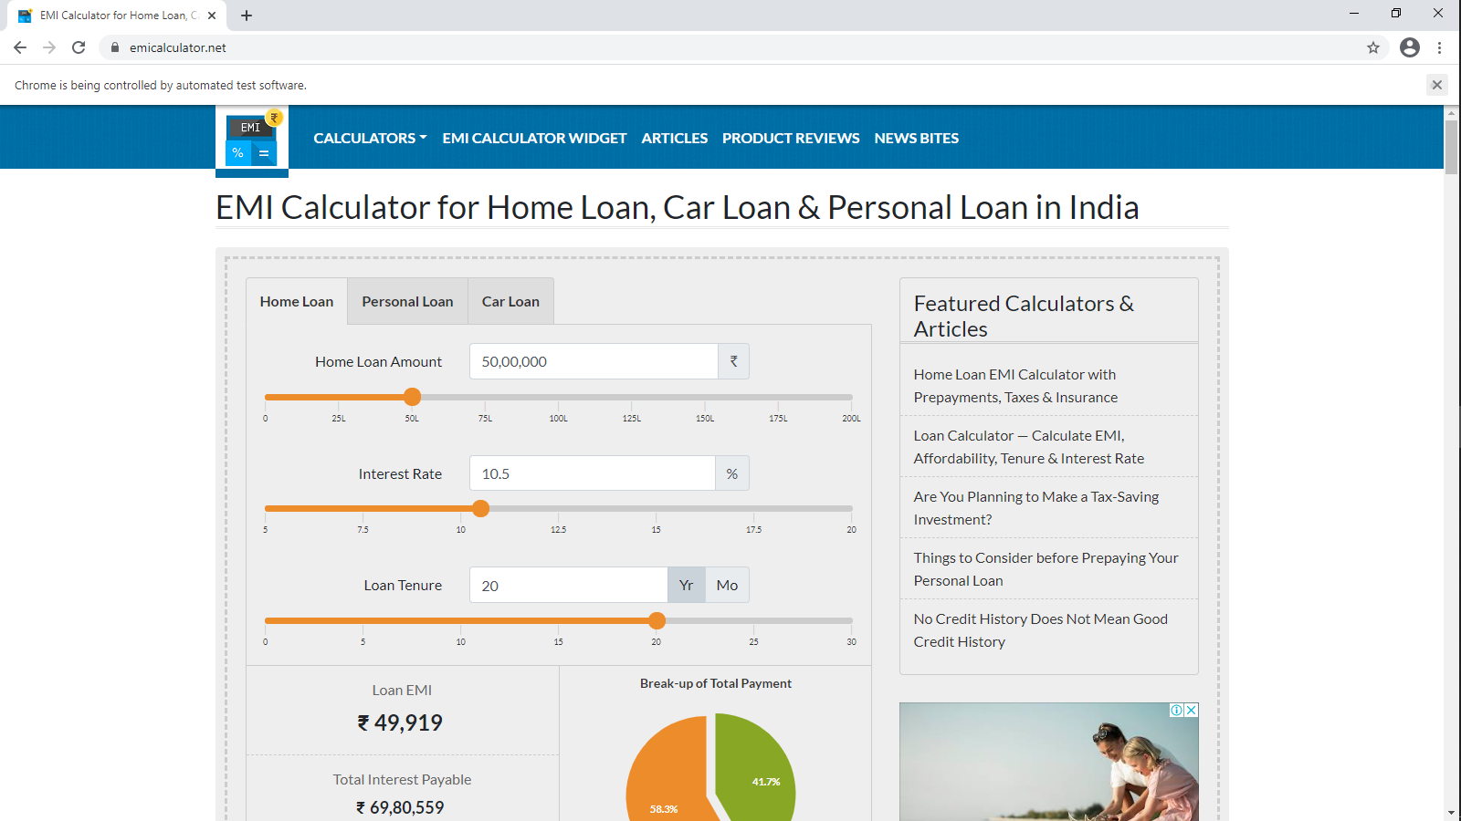
TEST URL

Slide 6
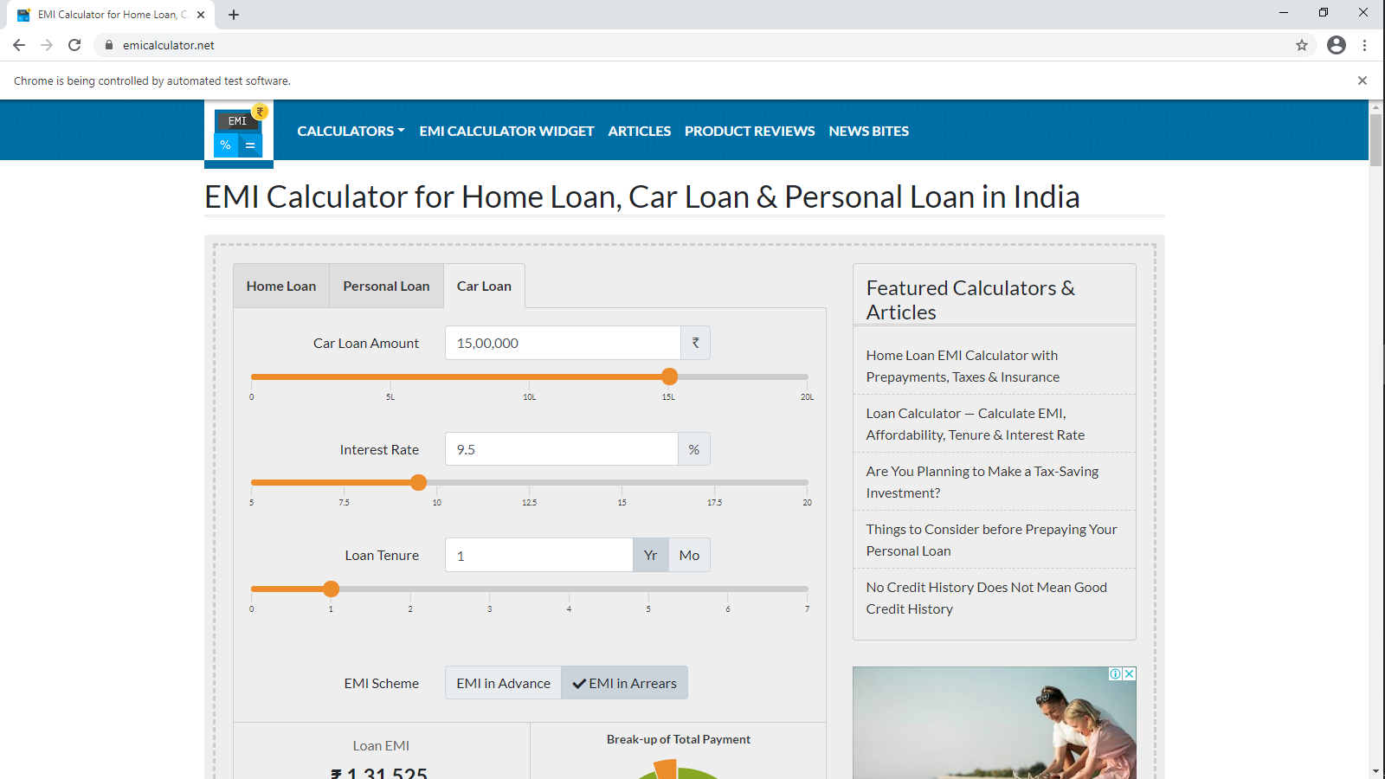
CAR LOAN EMI CALCULATOR

Slide 7
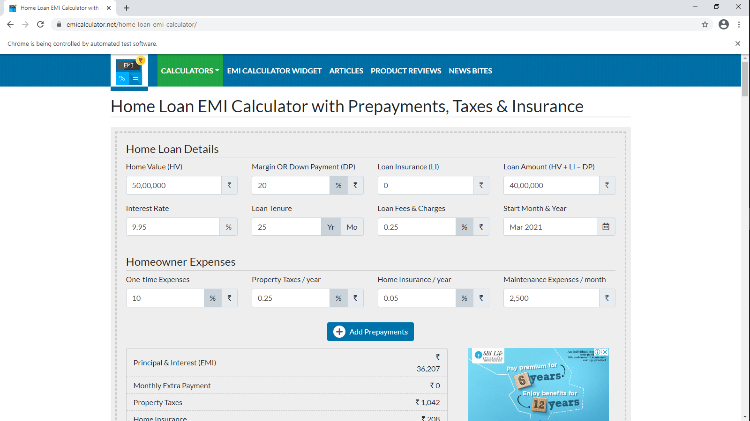
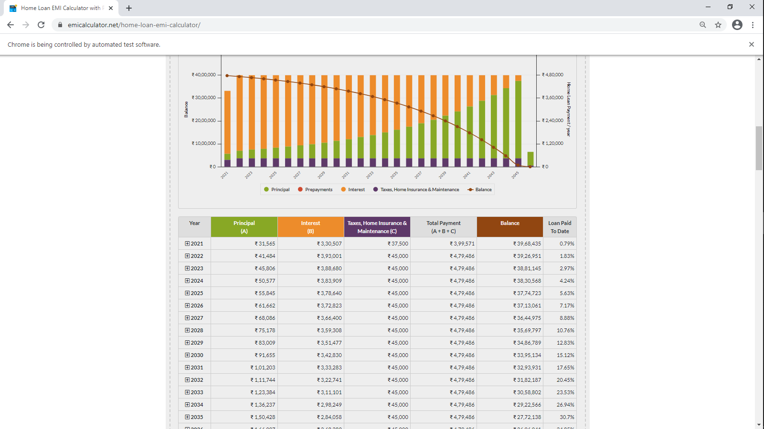
HOME LOAN EMI CALCULATOR

Slide 8
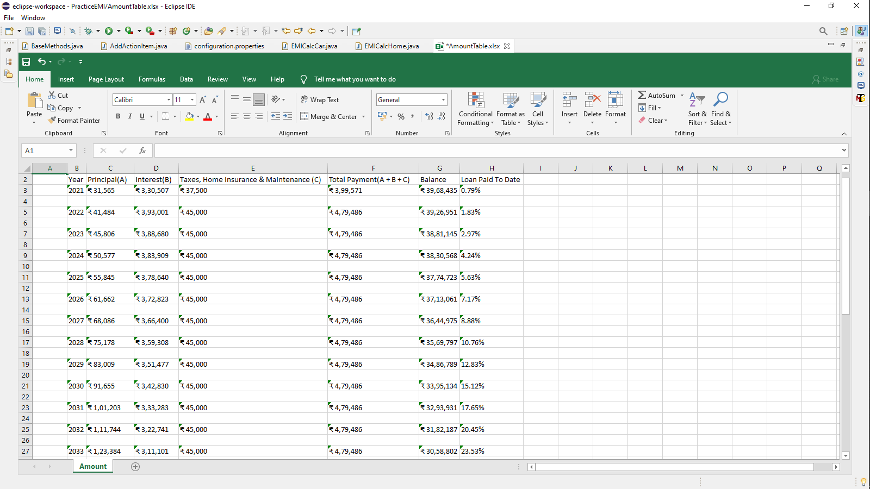
WRITING HOME LOAN DATA INTO EXCEL FILE

Slide 9
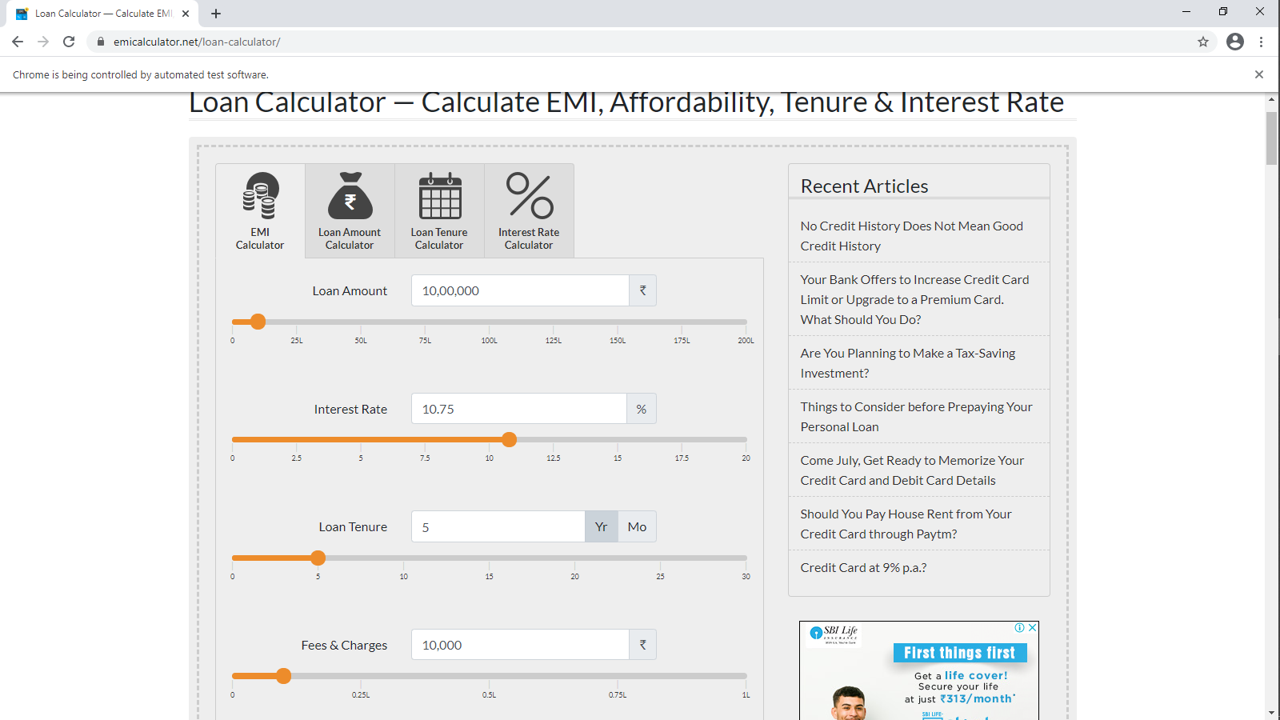
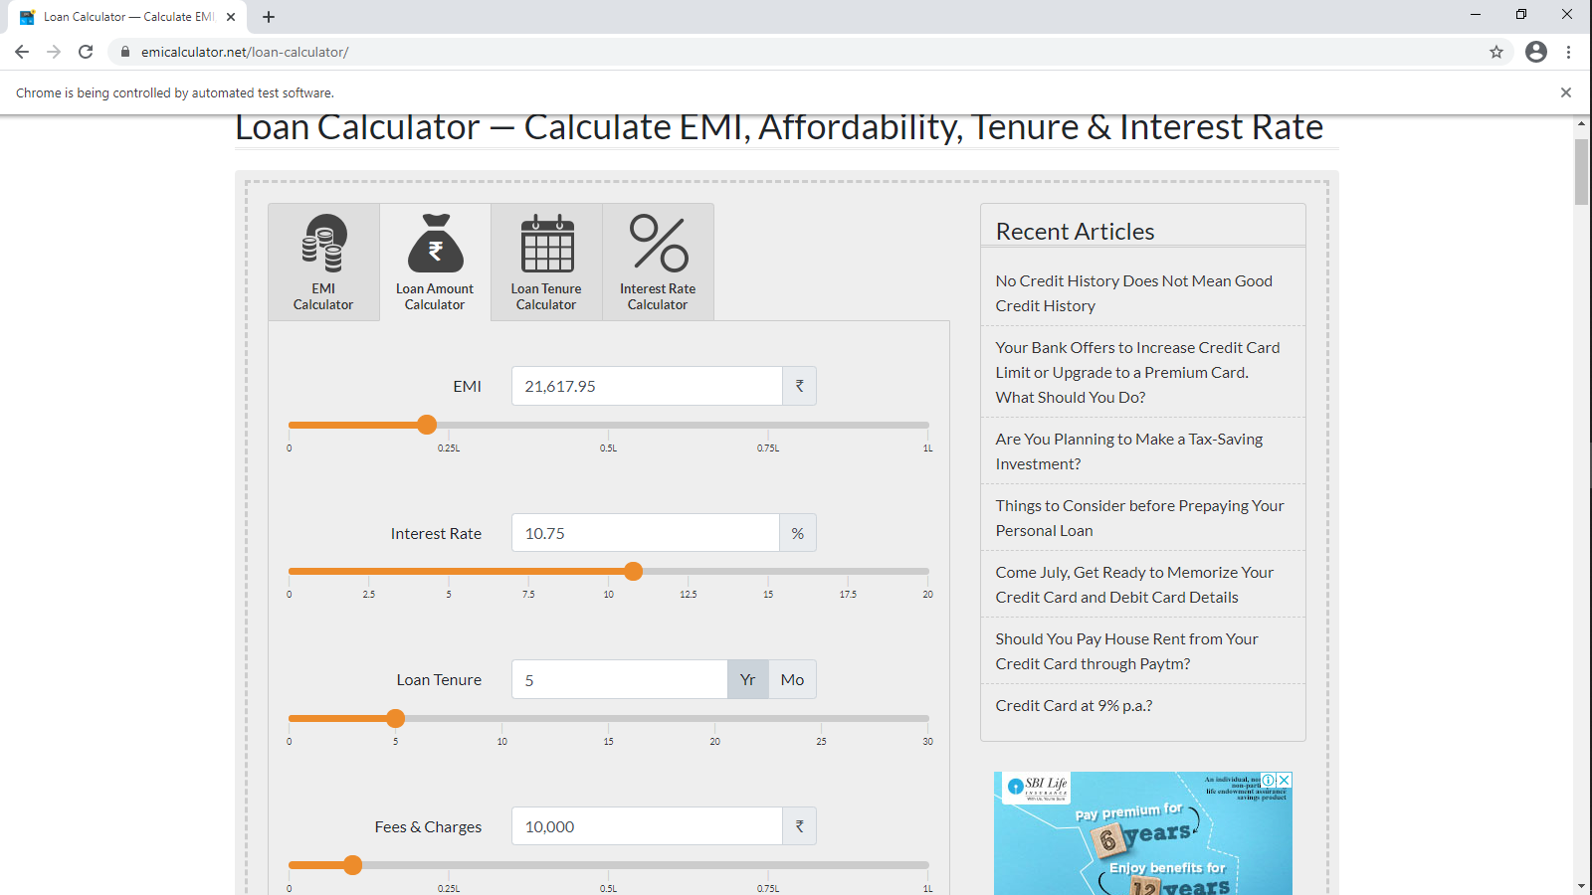
LOAN CALCULATORS

Slide 10
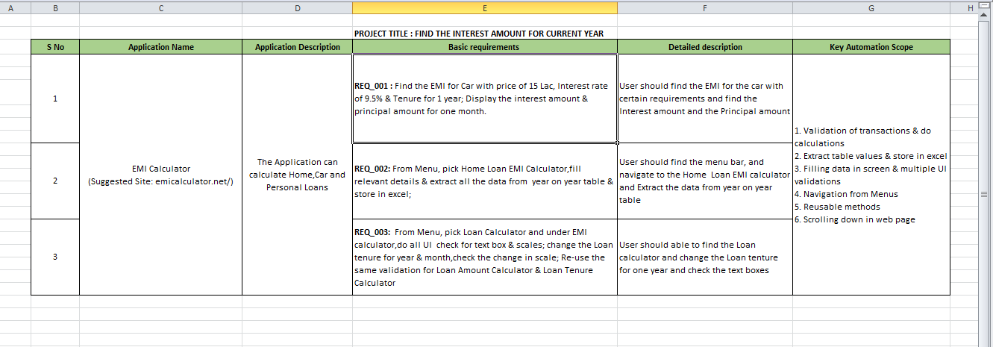
TESTING REQUIREMENTS

Slide 11
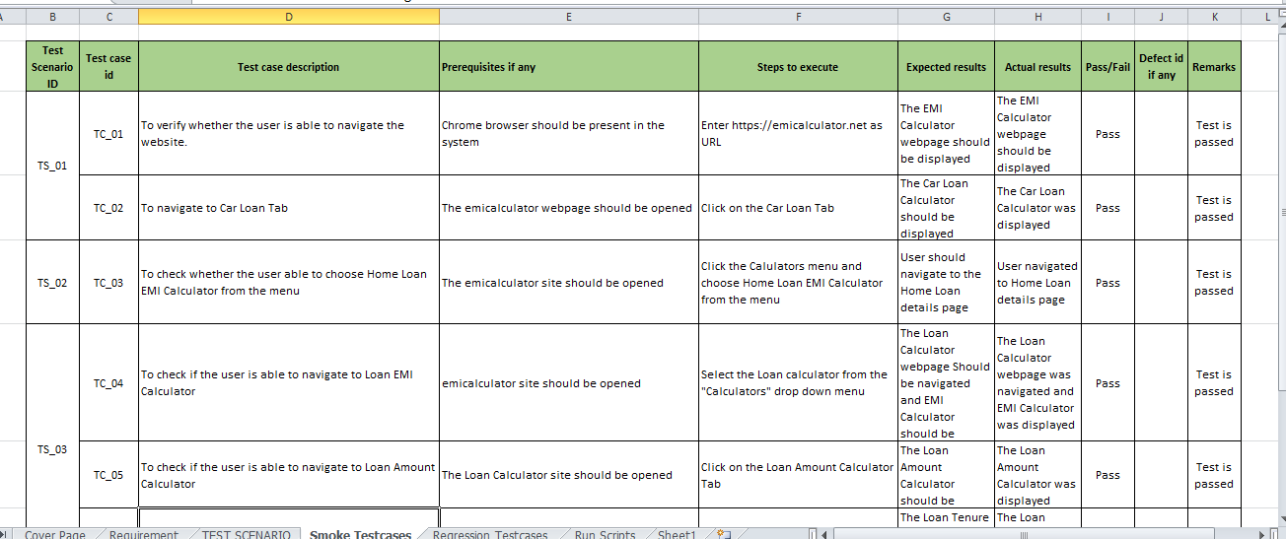
SMOKE TESTING

Slide 12
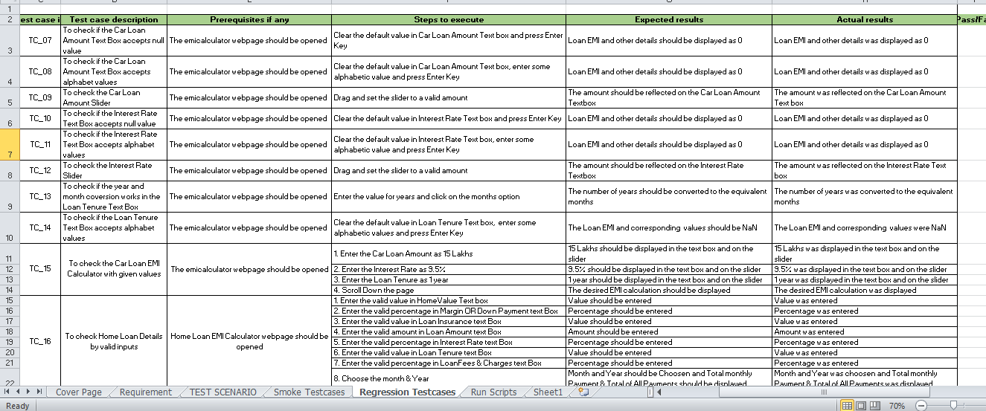
REGRESSION TESTING

Slide 13
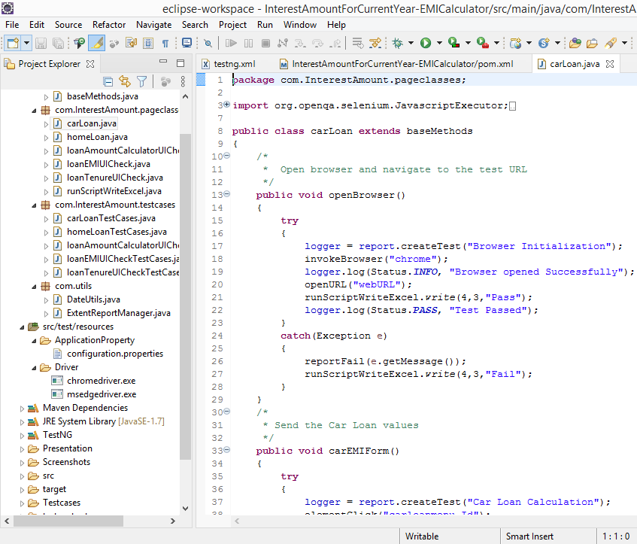
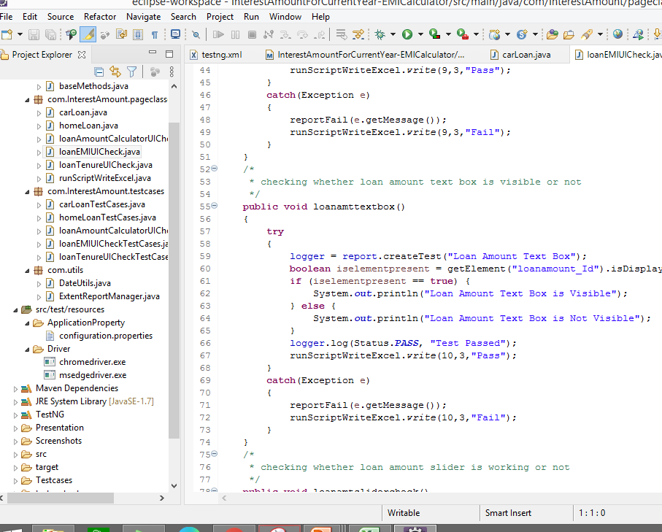
AUTOMATION SCRIPTS

Slide 14
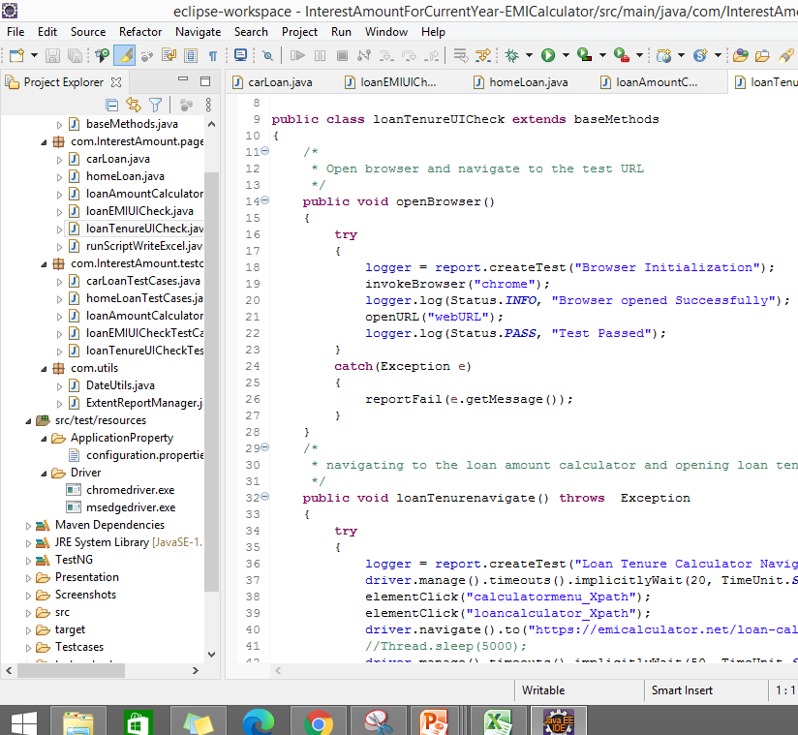
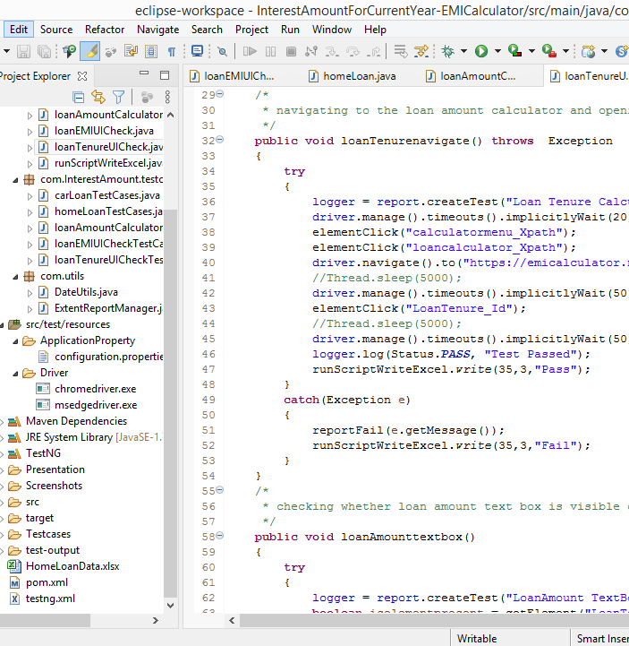
AUTOMATION SCRIPTS

Slide 15
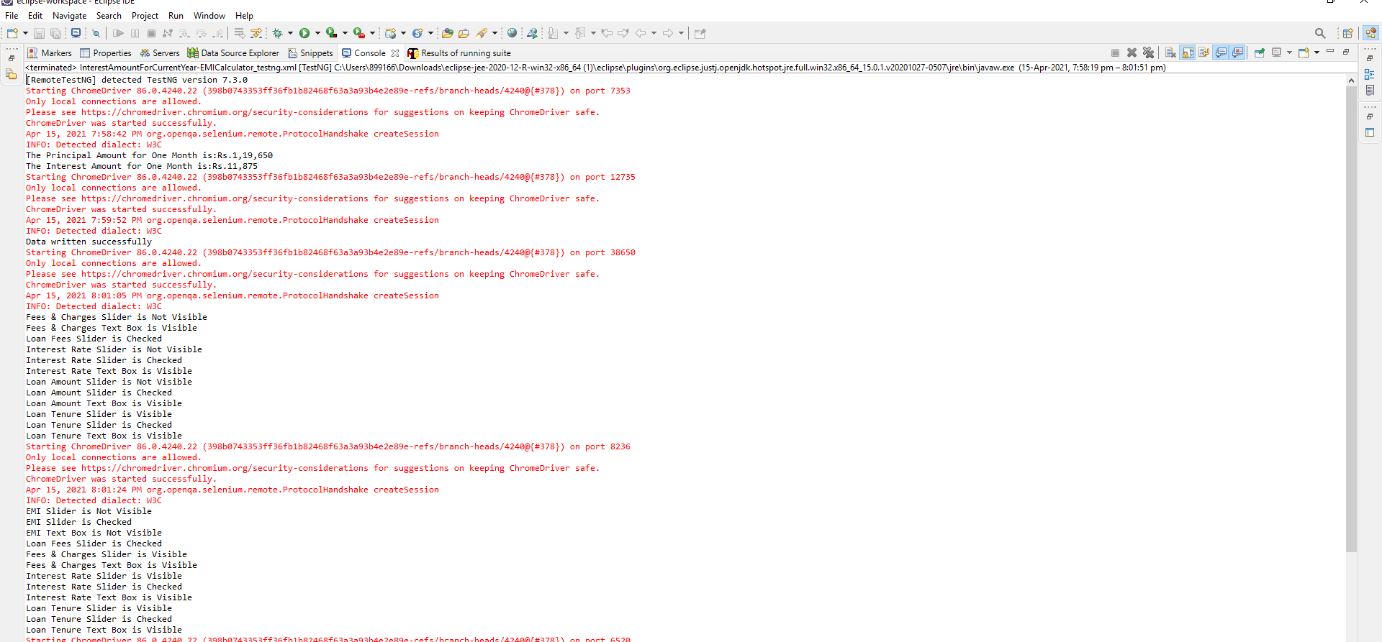
CONSOLE OUTPUT

Slide 16
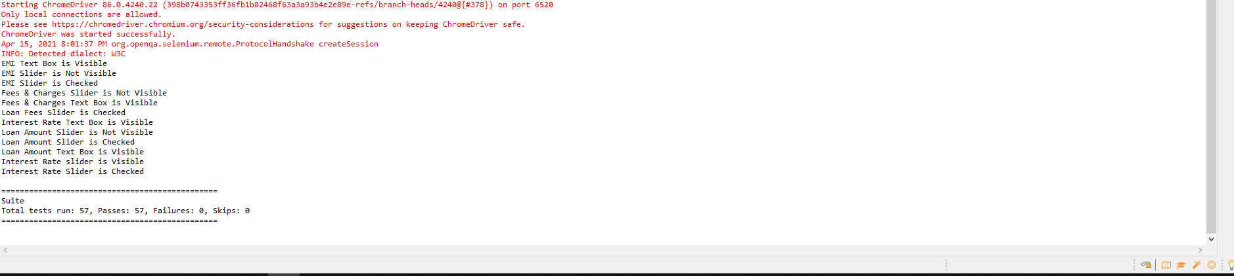

Slide 17
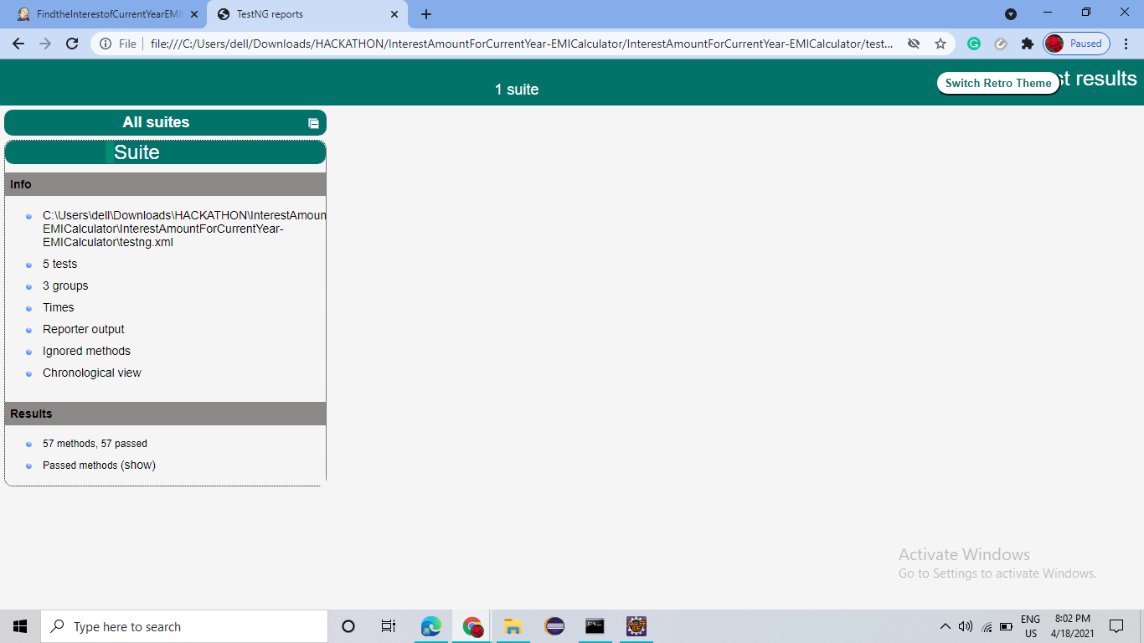
TESTNG REPORT

Slide 18
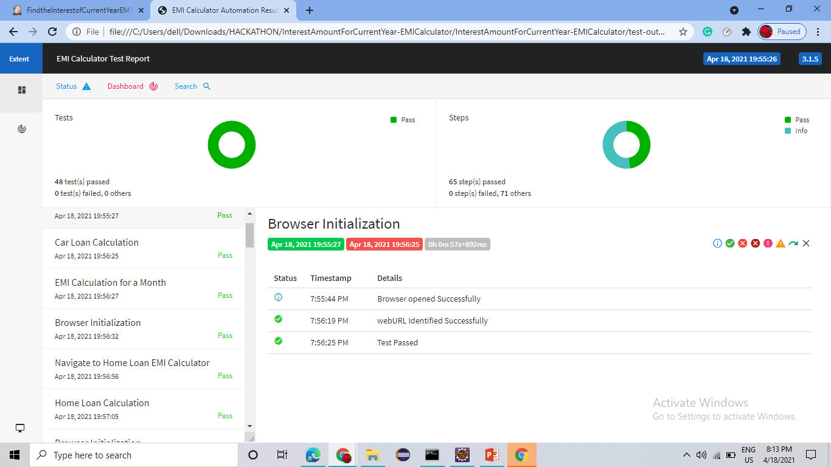
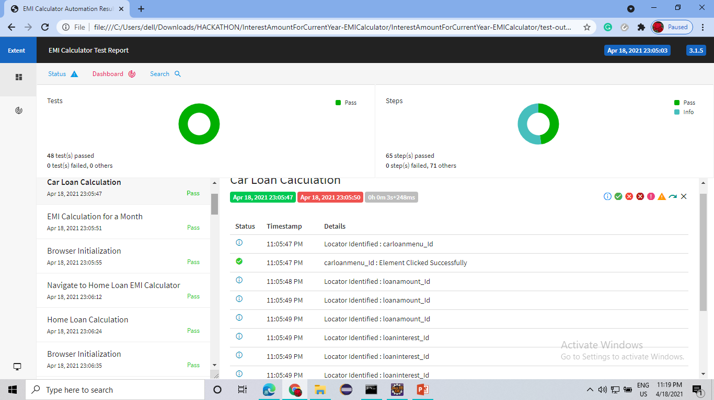
REPORT

Slide 19
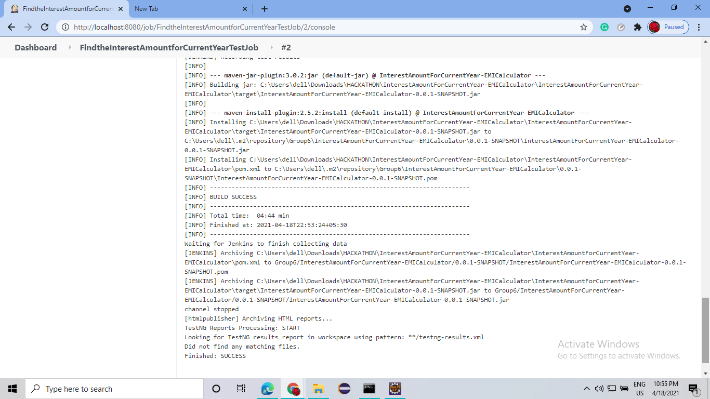
JENKINS OUTPUT

Slide 20
THANK YOU

